Slide 1


PREDICTORS OF HEALTH INSURANCE COVERAGE AND REPRODUCTIVE OUTCOMES AMONG WOMEN IN SELECTED AFRICAN COUNTRIES
BY BLESSING E. OLADOKUN

Slide 2
INTRODUCTION
Since the goal of UHC is that everyone has access to standard and basic healthcare services, when necessary, regardless of their financial status (Frenk, 2015); many African countries happen to fall in the category of people who have not been privileged to have readily accessible healthcare, either in that they are not remotely available to them, or they cannot afford it when it is available.
The lack of health insurance coverage has in fact had a spiral effect on other reproductive outcomes. Owing to lack of access to healthcare from pregnancy stage, many of these women have lost their pregnancy or lost the child while at infant stage. The aftermath of not having access to healthcare does not stop at the point of women been deprived of reproductive healthcare, it leaves a mark on the livelihood of the kids they deliver; a good number of kids born to these women who lacked care die within their first year of birth, and those who survive beyond the first year may not survive till age of five.
This study tries to trace this early child death to many pregnancy-related issues of the mothers; from access to ANC, timing to first attendance of ANC, number of ANC attended, history of pregnancy termination, delivery of child at a health facility, etc. The status of the child given-birth-to by these women was studied, to find out what background factors of the mothers (socio-demographics and pregnancy-related) can predict status of the child within their first year and after their first year of birth.

Slide 3
RESEARCH QUESTIONS
What are the background factors of the women in African countries that can be used in a predictive model to determine if they had lost a child?
What are the significant predictors of health insurance coverage for women of reproductive health, in African countries?
Can the 5-years outcome of a child, in terms of whether they are alive or dead, be determined based on the mother’s pregnancy-related factors?

Slide 4
DESCRIPTION OF DATA
The dataset for this project was obtained through DHS (https://dhsprogram.com/). The DHS has published the dataset for different countries in different years. The data was collected by the USAID funded program, DHS, through national surveys carried out in each of these countries. Worth of note is that the data was collected in different years in the different countries; but the target is the most recently collected data in each of the selected countries.
The DHS Kid’s Recode (KR) dataset for 11 African countries, including Angola, Egypt, Ethiopia, Gabon, Ghana, Kenya, Mali, Nigeria, South Africa, Zambia and Zimbabwe, were pooled into a single datafile for this project. The combined dataset across the 11 countries has record of 137,229 women and their most recent kids (under 5-year-old).
After cleaning the individual dataset for each of the specific objectives, some observations were lost and there were non-uniform number of observations (rows) for each of the subset.
For subset 1: There were 21 variables and 120,653 observations.
For subset 2: There were 26 variables and 70,382 observations.
For subset 3: There were 21 variables and 69,151 observations.

Slide 5
LIST OF PREDICTORS AND OUTCOME
Outcome | Predictors/Co-variates | Comment(s)
Number of children ever born | Age group of women Region Educational level of women Wealth index class Marital Status Age at first sexual intercourse History of pregnancy termination Smoking status of women | Outcome is categorized as follows: 0–1 child, 2–3 children, 4+ children 9 categorical predictors
Health insurance coverage | Age group of women Region Educational level of women Educational level of their partners Wealth index class Marital Status Currently pregnant History of pregnancy termination Timing of ANC visit Number of ANC visits during pregnancy Modern contraceptive use Child delivery in a health facility Delivery of index child by Caesarean Section Received Ante-natal care in health facilities | Outcome is categorized as: Yes- covered by insurance No- not covered by insurance 13 categorical predictors
Status of index child | Age group of women Region Educational level of women Wealth index class Marital Status Index child is single or multiple Sex of index child Preceding birth interval (in months) Duration of pregnancy (in months) History of pregnancy termination Child delivery in health facility Delivery of index child by CS Received Ante-natal care in health facilities Size of child at birth (in kg) Smoking status of women Ever lost a child previously Health insurance coverage | Outcome is categorized as: Still alive – within 5-years of birth Dead - within 5-years of birth 10 categorical predictors and 3 numerical predictors

Slide 6
METHODS
For the purpose of this project, descriptive statistics was used to explore the data prior to building and fitting of predictive and statistical models. All predictors and each of the outcome variables were explored and described with frequencies. The distribution of each of the 3 outcomes, by major socio-demographics, was also displayed using bar-charts.
Six predictive machine learning models were used to predict each of the outcomes; this includes – KNN, Naïve Bayes, Decision Tree (with Entropy and Gini criterion), Random Forest, Gradient Boosting, and Support Vector Machine. For each of the predictive models, a validation set approach was used and a 10-fold cross-validation approach was also used. All of the predictive models were executed in Python, with the aid of 3 key libraries, scikit-learn, pandas, and matplotlib…on the Google Collab environment.
The logistic regression was used as a statistical model to describe and explain the patterns and relationship between the predictors and each of the outcomes. The results from the logistic regression was presented in odds-ratio, by taking the exponential of the coefficient and its 95% confidence interval. After fitting the model on the training dataset, the model accuracy was evaluated on the test dataset. Model accuracy used were – True positive rate, False positive rate, and the Receiver Operating Characteristics (ROC) Curve. This was carried out in the R-software with the “caTools” and “ROCR” packages.

Slide 7
EXPLORATORY DATA ANALYSIS (PREDICTORS)
 | Frequency | Percentage
Country
Nigeria | 33,924 | 24.72
Kenya | 20,964 | 15.28
Egypt | 15,848 | 11.55
Angola | 14,322 | 10.44
Ethiopia | 10,641 | 7.75
Zambia | 9,959 | 7.26
Mali | 9,940 | 7.24
Zimbabwe | 6,132 | 4.47
Gabon | 6,067 | 4.42
Ghana | 5,884 | 4.29
South Africa | 3,548 | 2.59
Age group
15 – 19 years | 7,711 | 5.62
20 – 24 years | 30,941 | 22.55
25 – 29 years | 38, 882 | 28.33
30 – 34 years | 29,110 | 21.21
35 – 39 years | 19,313 | 14.07
40 – 44 years | 8,748 | 6.37
45 – 49 years | 2,524 | 1.84
Place of residence/Region
Rural | 86,671 | 63.16
Urban | 50,558 | 36.84
Level of education
No education | 45,315 | 33.02
Primary | 38,044 | 27.72
Secondary | 45,042 | 32.82
Tertiary/Higher | 8,828 | 6.43
Marital status
Married | 103,667 | 75.54
Never married | 25,578 | 18.64
Formerly married | 7,984 | 5.82
Wealth Index
Poorest | 37,290 | 33.02
Poorer | 29,984 | 21.85
Middle | 26,813 | 19.54
Richer | 23,033 | 16.78
Richest | 20,109 | 14.65

Slide 8
EXPLORATORY DATA ANALYSIS (PREDICTORS)
 | Frequency | Percentage
Currently pregnant
No or unsure | 123,154 | 89.74
Yes | 14,075 | 10.26
Ever terminated a pregnancy
No | 108,958 | 79.40
Yes | 17,394 | 12.68
No response | 10,877 | 7.93
Number of lost children
None | 103,774 | 75.62
One child | 21,348 | 15.56
2+ children | 12,107 | 8.82
Status of last child (born within the last 5 years)
Alive | 129,218 | 94.16
Dead | 8,011 | 5.84

Slide 9
EXPLORATORY DATA ANALYSIS (OUTCOMES)
 | Frequency | Percentage
Has health insurance
No | 111,428 | 81.20
Yes | 13,134 | 9.57
No response | 12,667 | 9.23
Ever lost a child
Never | 103,774 | 75.62
Yes | 33,455 | 24.38
Status of last child (born within the last 5 years)
Alive | 129,218 | 94.16
Dead | 8,011 | 5.84

Slide 10
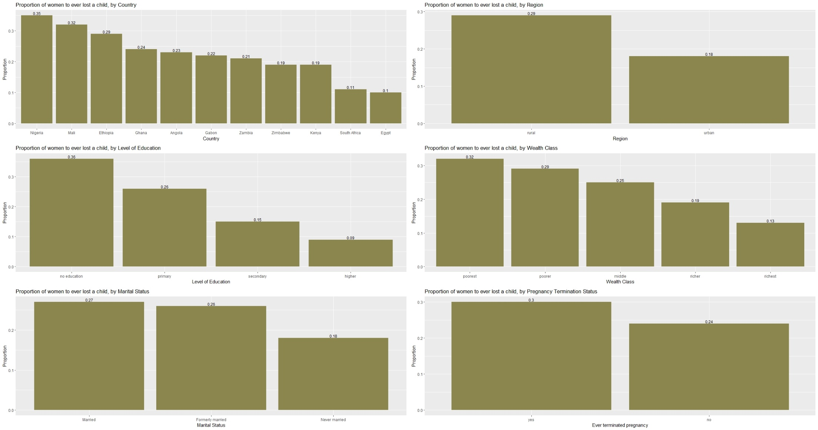

Slide 11
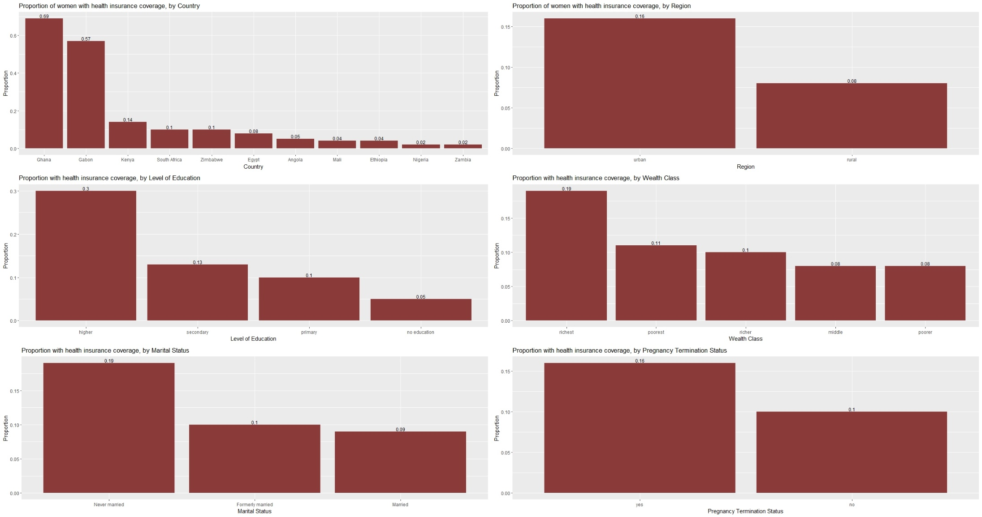

Slide 12
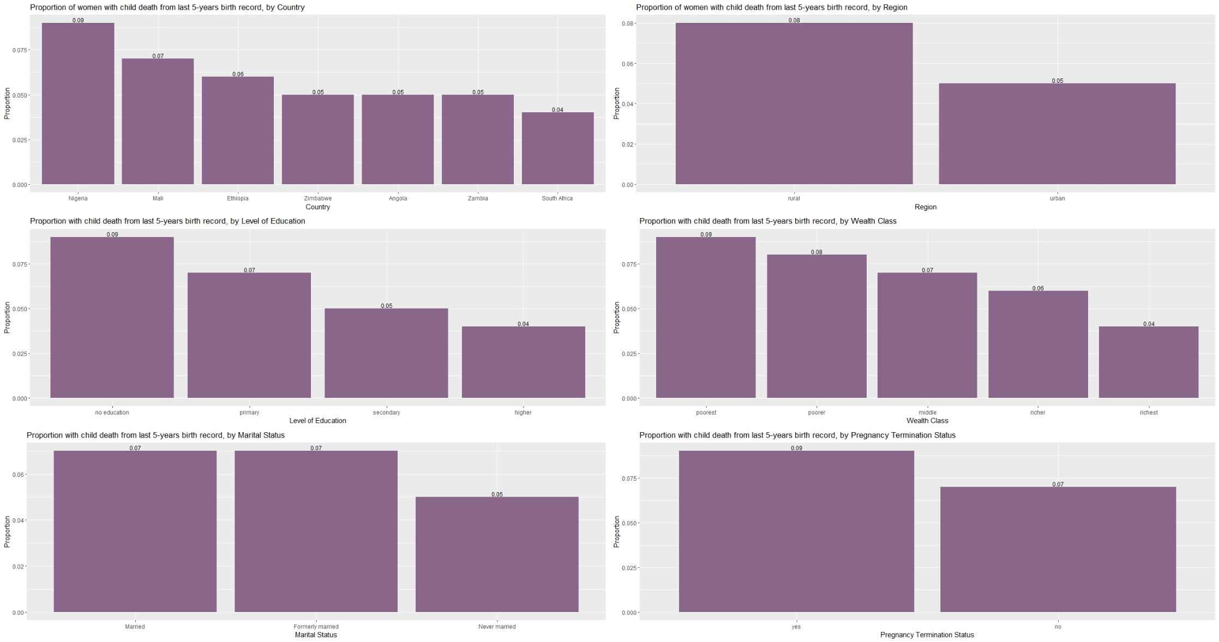

Slide 13
 | Odds-Ratio (OR) | 95% CI (OR)
Country
Nigeria | 1
Mali | 0.7809 | 0.7356 – 0.8289
Zimbabwe | 0.6155 | 0.5660 – 0.6688
Ethiopia | 0.6410 | 0.6041 – 0.6801
Angola | 0.6016 | 0.5600 – 0.6463
Ghana | 0.5868 | 0.5419 – 0.6351
Gabon | 0.5486 | 0.4997 – 0.6020
Zambia | 0.4806 | 0.4493 – 0.5139
Kenya | 0.4258 | 0.3975 – 0.4558
South Africa | 0.3467 | 0.3030 – 0.3956
Egypt | 0.2901 | 0.2696 – 0.3120
Type of place of residence
Rural | 1
Urban | 0.9343 | 0.8948 – 0.9755
Age Group
15 – 19 years | 1
20 -24 years | 1.8582 | 1.6847 – 2.0532
25 – 29 years | 3.2013 | 2.9087 – 3.5298
30 – 34 years | 4.8527 | 4.4053 – 5.3552
35 – 39 years | 6.5750 | 5.9569 – 7.2697
40 – 44 years | 9.6044 | 8.6358 – 10.6979
45 – 49 years | 11.8129 | 10.3235 – 13.5327
Level of Education
No education | 1
Primary | 0.9026 | 0.8643 – 0.9425
Secondary | 0.6520 | 0.6205 – 0.6849
Higher/Tertiary | 0.4134 | 0.3713 – 0.4596
Wealth Index
Poorest | 1
Poorer | 0.9873 | 0.9454 – 1.0311
Middle | 0.8329 | 0.7933 – 0.8744
Richer | 0.6629 | 0.6250 – 0.7029
Richest | 0.5008 | 0.4648 – 0.5394
Marital Status
Married | 1
Formerly married | 0.9638 | 0.8974 – 1.0347
Never married | 0.8100 | 0.7614 – 0.8615
Age at first sex
Below 18 years | 1
18 – 24 years | 0.7088 | 0.6722 – 0.7473
25 – 29 years | 0.5248 | 0.5010 – 0.5495
30+ years | 0.2963 | 0.2136 – 0.4019
Ever terminated a pregnancy
No | 1
Yes | 1.3073 | 1.2495 – 1.3675
Ever/Currently smokes
No | 1
Yes | 1.3924 | 1.1801 – 1.6400

Slide 14
 | Odds-Ratio (OR) | 95% CI (OR)
Country
Nigeria | 1
Ghana | 181.9341 | 157.8816 – 210.1316
Gabon | 115.3262 | 98.4569 – 135.3495
Kenya | 9.5147 | 8.2494 – 10.9905
Zimbabwe | 5.4552 | 4.5938 – 6.4789
South Africa | 5.0290 | 3.9410 – 6.3821
Angola | 4.5376 | 3.8137 – 5.3985
Mali | 3.6111 | 2.9696 – 4.3814
Egypt | 2.3141 | 2.0091 – 2.6686
Ethiopia | 2.1874 | 1.8131 – 2.6327
Zambia | 0.8700 | 0.6911 – 1.0872
Type of place of residence
Rural | 1
Urban | 0.9030 | 0.8342 – 0.9774
Age Group
15 – 19 years | 1
20 – 24 years | 1.0668 | 0.9168 – 1.2435
25 – 29 years | 1.4941 | 1.2869 – 1.7382
30 – 34 years | 1.9443 | 1.6693 – 2.7458
35 – 39 years | 2.377 | 1.9938 – 2.7458
40 – 44 years | 2.4235 | 2.0260 – 2.9021
45 – 49 years | 1.9022 | 1.4660 – 2.4619
Level of Education
No education | 1
Primary | 1.3513 | 1.2135 – 1.5051
Secondary | 1.7948 | 1.6081 – 2.0042
Higher/Tertiary | 9.2190 | 8.0673 – 10.5415
Wealth Index
Poorest | 1
Poorer | 0.7996 | 0.7223 – 0.8850
Middle | 0.8771 | 0.7875 – 0.9768
Richer | 1.1442 | 1.0185 – 1.2855
Richest | 2.1695 | 1.9039 – 2.4731
Marital Status
Married | 1
Formerly married | 0.6501 | 0.5666 – 0.7445
Never married | 0.8905 | 0.8082 – 0.9810
Current contraceptive method
None | 1
Non-modern method | 0.9381 | 0.8102 – 1.0846
Modern method | 1.0974 | 1.0205 – 1.1803
Currently pregnant
No | 1
Yes | 1.1419 | 1.0272 – 1.2683
ANC facility used (at last delivery)
Non-health facility | 1
Health facility | 1.3028 | 1.1594 – 1.4651
CS at last birth
No | 1
Yes | 1.1260 | 1.0257 – 1.2360
Place of last delivery
Out-of-health-facility | 1
Health facility | 1.3876 | 1.2767 – 1.5086
Ever lost a child after birth
No | 1
Yes | 0.8854 | 0.8125 – 0.9644

Slide 15
 | Odds-Ratio (OR) | 95% CI (OR)
Country
Nigeria | 1
South Africa | 2.5606 | 2.0337 – 3.2505
Angola | 2.3175 | 2.0265 – 2.6532
Zambia | 2.1407 | 2.8823 – 2.4403
Mali | 1.9220 | 1.7270 – 2.1424
Zimbabwe | 2.1242 | 1.8419 – 2.4587
Ethiopia | 1.8995 | 1.7714 – 2.1121
Age Group
15 – 19 years | 1
20 -24 years | 1.1237 | 0.9539 – 1.3969
25 – 29 years | 1.3043 | 1.1364 – 1.4929
30 – 34 years | 1.3217 | 1.1468 – 1.5195
35 – 39 years | 1.2209 | 1.0540 – 1.4112
40 – 44 years | 1.1020 | 0.9339 – 1.2996
45 – 49 years | 0.7561 | 0.6148 – 0.9326
Level of Education
No education | 1
Primary | 1.0628 | 0.9767 – 1.1541
Secondary | 1.2624 | 1.1454 – 1.3919
Higher/Tertiary | 1.6375 | 1.3384 – 2.0163
Wealth Index
Poorest | 1
Poorer | 0.9958 | 0.9182 – 1.0800
Middle | 1.0551 | 0.9621 – 1.1575
Richer | 1.2540 | 1.1187 – 1.4070
Richest | 1.5210 | 1.3110 – 1.7673
Marital Status
Married | 1
Formerly married | 0.7605 | 0.6655 – 0.8721
Never married | 0.9979 | 0.8810 – 1.1316
Ever terminated a pregnancy
No | 1
Yes | 0.7825 | 0.7158 – 0.8324
CS at last birth
No | 1
Yes | 0.7047 | 0.5995 – 0.8324
Number of births
Single birth | 1
Multiple births | 0.3481 | 0.3106 – 0.3907
Sex of last child
Female | 1
Male | 0.8232 | 0.7750 – 0.8744
Duration of last pregnancy
Pre-term (before 9 month) | 1
Term (9 month) | 5.1363 | 4.5027 – 5.8491
Post-term (after 9 month) | 5.3068 | 4.1389 – 6.8724
ANC facility used (at last delivery)
Non-health facility | 1
Health facility | 2.2704 | 2.1110 – 2.4432

Slide 16
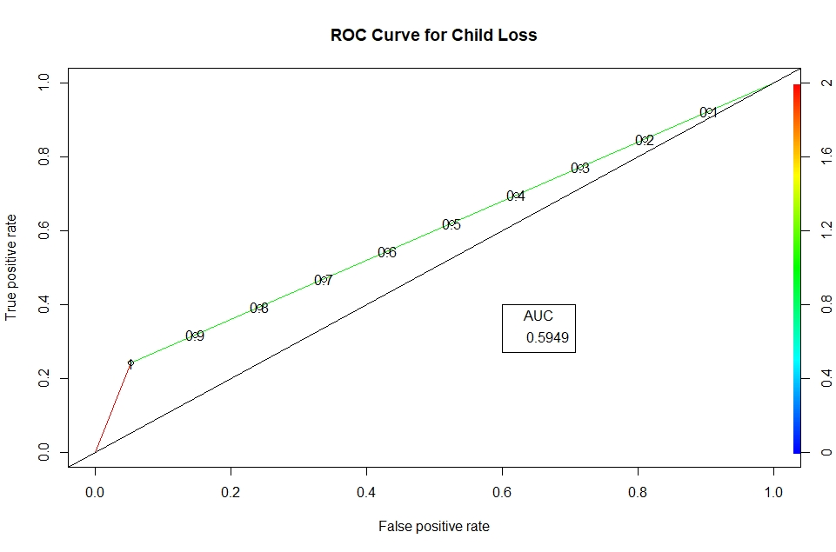
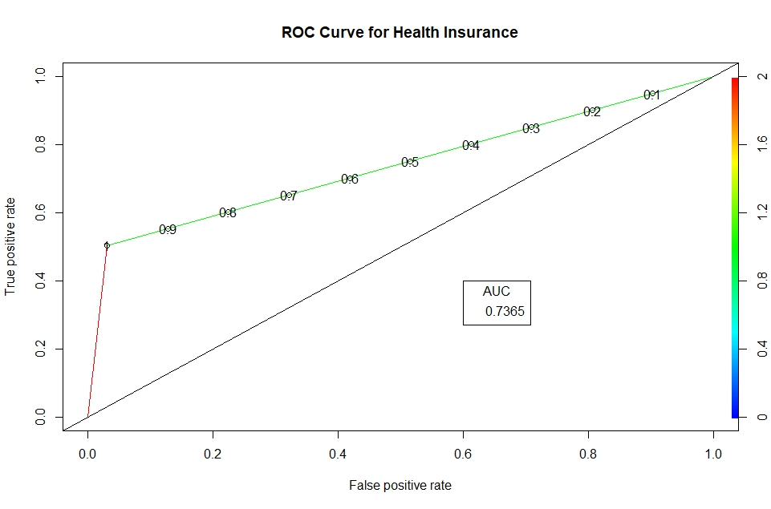
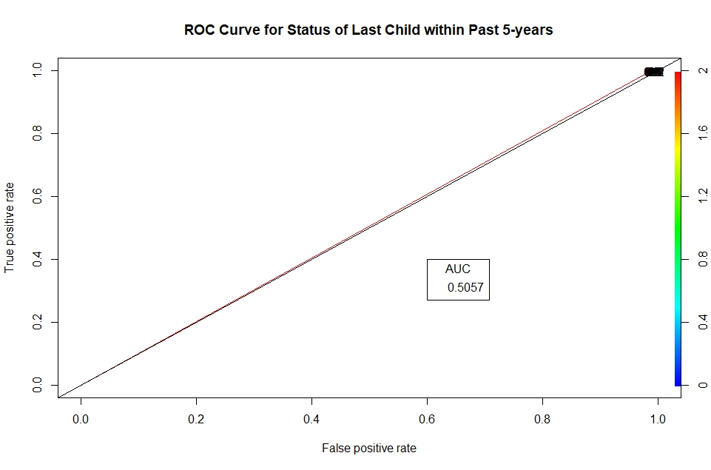
MODEL ACCURACY OF LOGISTIC REGRESSION (ON TEST SET)

Slide 17
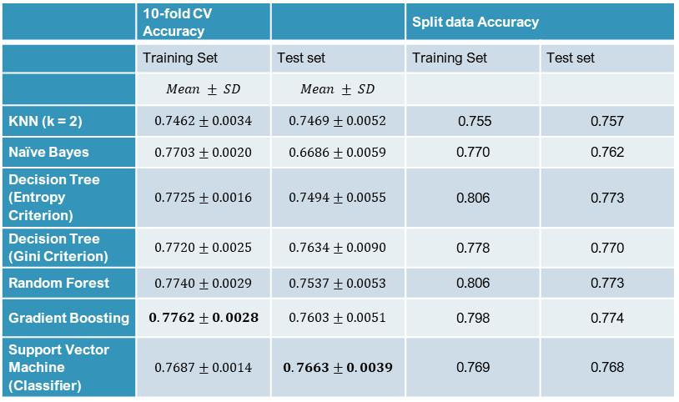
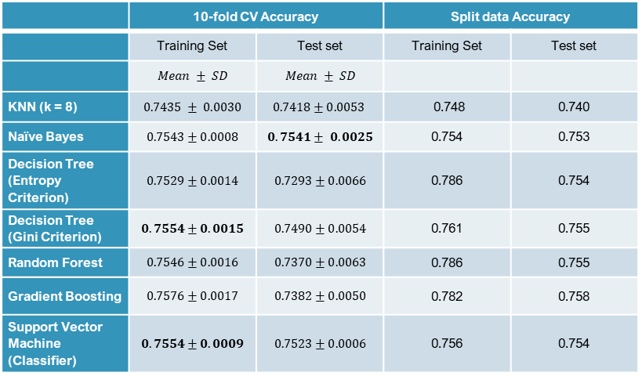
RESULT OF PREDICTIVE MODELS
Machine learning models to predict “Number of lost child- 0, 1, 2+.”
Machine learning models to predict “Ever lost a child- Yes, No.”
 | 10-fold CV Accuracy |  | Split data Accuracy
 | Training Set | Test set | Training Set | Test set
 | $$Mean ± SD$$ | $$Mean ± SD$$
KNN (k = 8) | $$0.7435 ± 0.0030$$ | $$0.7418±0.0053$$ | 0.748 | 0.740
Naïve Bayes | $$0.7543±0.0008$$ | $$0.7541± 0.0025$$ | 0.754 | 0.753
Decision Tree (Entropy Criterion) | $$0.7529±0.0014$$ | $$0.7293±0.0066$$ | 0.786 | 0.754
Decision Tree (Gini Criterion) | $$0.7554±0.0015$$ | $$0.7490±0.0054$$ | 0.761 | 0.755
Random Forest | $$0.7546±0.0016$$ | $$0.7370±0.0063$$ | 0.786 | 0.755
Gradient Boosting | $$0.7576±0.0017$$ | $$0.7382±0.0050$$ | 0.782 | 0.758
Support Vector Machine (Classifier) | $$0.7554±0.0009$$ | $$0.7523±0.0006$$ | 0.756 | 0.754
 | 10-fold CV Accuracy |  | Split data Accuracy
 | Training Set | Test set | Training Set | Test set
 | $$Mean ± SD$$ | $$Mean ± SD$$
KNN (k = 2) | $$0.7462±0.0034$$ | $$0.7469±0.0052$$ | 0.755 | 0.757
Naïve Bayes | $$0.7703±0.0020$$ | $$0.6686±0.0059$$ | 0.770 | 0.762
Decision Tree (Entropy Criterion) | $$0.7725±0.0016$$ | $$0.7494±0.0055$$ | 0.806 | 0.773
Decision Tree (Gini Criterion) | $$0.7720±0.0025$$ | $$0.7634±0.0090$$ | 0.778 | 0.770
Random Forest | $$0.7740±0.0029$$ | $$0.7537±0.0053$$ | 0.806 | 0.773
Gradient Boosting | $$0.7762±0.0028$$ | $$0.7603±0.0051$$ | 0.798 | 0.774
Support Vector Machine (Classifier) | $$0.7687±0.0014$$ | $$0.7663±0.0039$$ | 0.769 | 0.768

Slide 18
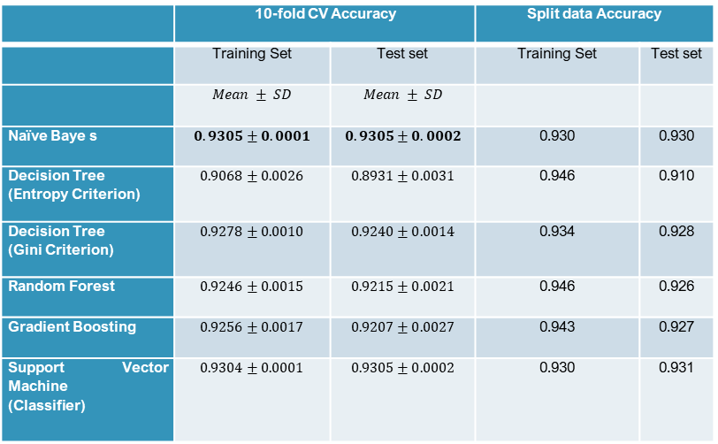
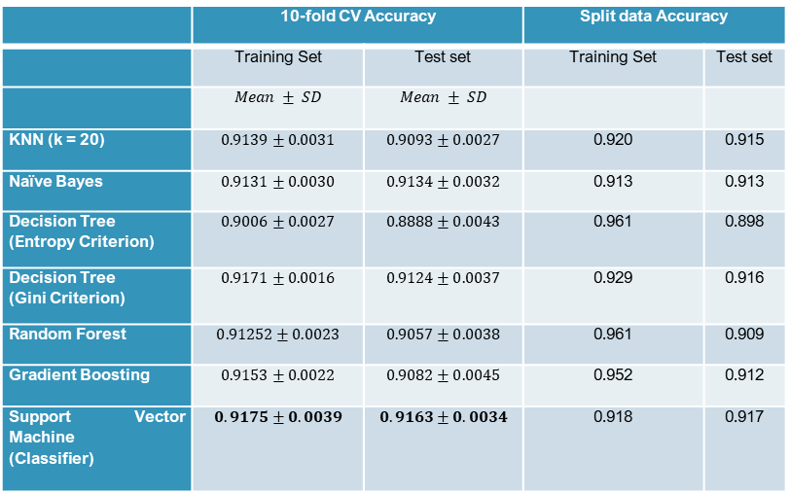
RESULT OF PREDICTIVE MODELS
Machine models used to predict “Health Insurance- Yes, No.”
Machine models used to predict “Child Status- Alive, Dead.”
 | 10-fold CV Accuracy |  | Split data Accuracy
 | Training Set | Test set | Training Set | Test set
 | $$Mean ± SD$$ | $$Mean ± SD$$
KNN (k = 20) | $$0.9139±0.0031$$ | $$0.9093±0.0027$$ | 0.920 | 0.915
Naïve Bayes | $$0.9131±0.0030$$ | $$0.9134±0.0032$$ | 0.913 | 0.913
Decision Tree (Entropy Criterion) | $$0.9006±0.0027$$ | $$0.8888±0.0043$$ | 0.961 | 0.898
Decision Tree (Gini Criterion) | $$0.9171±0.0016$$ | $$0.9124±0.0037$$ | 0.929 | 0.916
Random Forest | $$0.91252±0.0023$$ | $$0.9057±0.0038$$ | 0.961 | 0.909
Gradient Boosting | $$0.9153±0.0022$$ | $$0.9082±0.0045$$ | 0.952 | 0.912
Support Vector Machine (Classifier) | $$0.9175±0.0039$$ | $$0.9163±0.0034$$ | 0.918 | 0.917
 | 10-fold CV Accuracy |  | Split data Accuracy
 | Training Set | Test set | Training Set | Test set
 | $$Mean ± SD$$ | $$Mean ± SD$$
Naïve Baye s | $$0.9305±0.0001$$ | $$0.9305±0.0002$$ | 0.930 | 0.930
Decision Tree (Entropy Criterion) | $$0.9068±0.0026$$ | $$0.8931±0.0031$$ | 0.946 | 0.910
Decision Tree (Gini Criterion) | $$0.9278±0.0010$$ | $$0.9240±0.0014$$ | 0.934 | 0.928
Random Forest | $$0.9246±0.0015$$ | $$0.9215±0.0021$$ | 0.946 | 0.926
Gradient Boosting | $$0.9256±0.0017$$ | $$0.9207±0.0027$$ | 0.943 | 0.927
Support Vector Machine (Classifier) | $$0.9304±0.0001$$ | $$0.9305±0.0002$$ | 0.930 | 0.931

Slide 19
SUMMARY AND CONCLUSION
SUMMARY ON THE PREDICTIVE MODELS (NO. OF LOST CHILD)
SUMMARY ON THE PREDICTIVE MODELS (EVER LOST A CHILD)
In predicting number of lost children by a woman, using the 10-fold CV; the best prediction accuracy on training set was 75.54% by the Decision Tree (Gini Criterion) and SVM.
On the test set, the best prediction was obtained from the Naïve Bayes.
Importantly, better prediction on the same outcome was obtained using the validation set approach; 78.6% on training set (Decision Tree and Random Forest) and 75.8% on the test set (Gradient Boosting).
Using the binary outcome, “ever lost a child”…Gradient Boosting gave the best accuracy on the training set (77.62%), while SVM gave the best prediction on the test set (76.63%)…with the 10-fold CV
Also importantly, the validation set approach turned out to have the best prediction on the training set with 80.6% accuracy (from the Decision Tree and Random Forest). But, Gradient Boosting model gave the best prediction on the test set (77.4%).

Slide 20
SUMMARY AND CONCLUSION
SUMMARY ON THE PREDICTIVE MODELS (HEALTH INSURANCE)
SUMMARY ON THE PREDICTIVE MODELS (STATUS OF CHILD)
Overall, the predictive models performed excellently well on two outcomes – health insurance and child status.
The lowest prediction obtained on the health insurance from the training set was 90.06% (Decision Tree).
On the test set for the health insurance outcome, the lowest prediction was 88.88%.
The prediction on the same outcome was as high as 96.1% using the validation set approach. Also from the Decision Tree model.
The Naïve Bayes method gave the best accuracy on predicting status of child, with an accuracy of 93.05% on both training and test set of the 10-fold CV.
For the same outcome, using the validation set approach, the prediction was as high as 94.6% on the training set, with the Decision Tree and Random Forest models.

Slide 21
SUMMARY AND CONCLUSION
SUMMARY ON LOGISTIC MODEL
SUMMARY ON THE PREDICTIVE MODELS
The logistic model gave the best accuracy on the “health insurance” outcome; with an AUC of 73.65%.
The same model had a lower accuracy on the “child loss” outcome; with an AUC of 59.49%.
And it was lowest for “child status within 5-years of birth”; with an AUC of 50.57%.
The SVM was generally the best predictive model for all outcomes; as it gave the best prediction on most of the outcomes; 10-fold CV training set of number of child lost, 10-fold CV test set of ever lost a child, 10-fold CV of both training and test set of health insurance, and test set of the split data of Child status.

Slide 22
THANK YOU!

